Slide 1
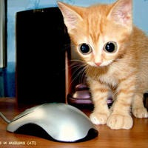
My Portfolio is a collection of notes and questions collected over the course of the term.
Part 1 Networks & Network Security
Part 2 About Hardware
SOLUTIONS
Peter Faulks
Peter Faulks Year 7 Digital Technologies. Slide 1

Slide 2

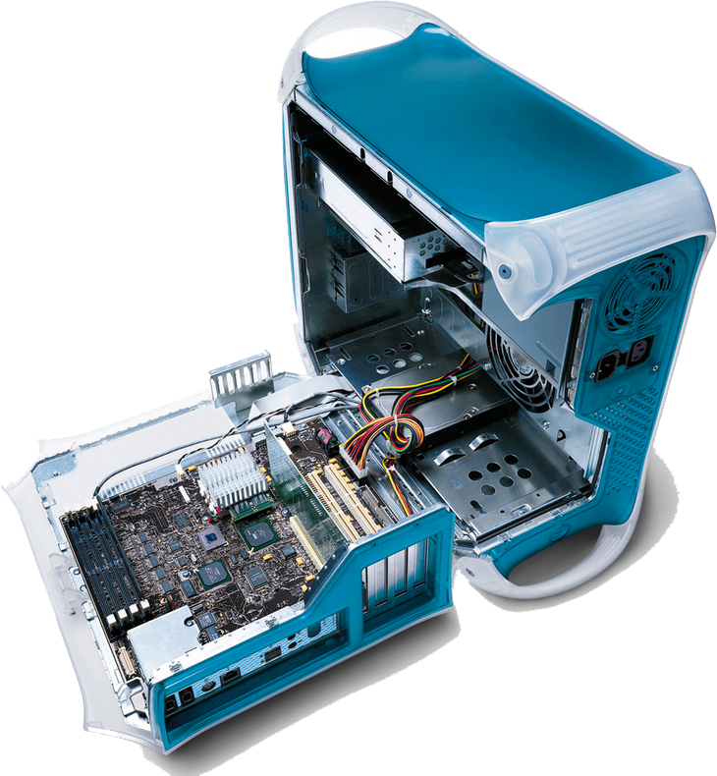
My Portfolio
Table of Contents
Your Name
Part 1 Network Security
Part 2 Computer Hardware
Peter Faulks Year 7 Digital Technologies. Slide 2

Slide 3
Spam is any kind of unwanted, unsolicited digital communication that gets sent out in bulk. Often spam is sent via email, but it can also be distributed via text messages, phone calls, or social media.
Spammers use many forms of communication to bulk-send their unwanted messages. Some of these are marketing messages peddling unsolicited goods. Other types of spam messages can spread malware, trick you into divulging personal information, or scare you into thinking you need to pay to get out of trouble.
Email spam filters catch many of these types of messages, and phone carriers often warn you of a “spam risk” from unknown callers. Whether via email, text, phone, or social media, some spam messages do get through, and you want to be able to recognize them and avoid these threats. Below are several types of spam to look out for.
Phishing emails
Phishing emails are a type of spam cybercriminals send to many people, hoping to “hook” a few people. Phishing emails trick victims into giving up sensitive information like website logins or credit card information.
Peter Faulks Portfolio
Network Security
What is spam?
https://www.malwarebytes.com/spam
Peter Faulks Year 7 Digital Technologies. Slide 3

Slide 4
Peter Faulks Portfolio
What is malware?
Many types of malware exist, including
Malware is any type of software created to harm or exploit another piece of software or hardware. Short for “malicious software,” malware is a collective term used to describe viruses, ransomware, spyware, Trojans, and any other type of code or software built with malicious intent.
Briefly describe each and what they do.
Ransomware is a type of malicious software (malware). When it gets into your device, it makes your computer or its files unusable. Cybercriminals use ransomware to deny you access to your files or devices. They then demand you pay them to get back your access.
Spyware are programs designed to track all of your computer activities, from which applications you use to which websites you visit. Adware are programs that pop-up various advertisements and offers, often based on the websites you visit.
A Trojan, or Trojan horse, is a type of malware that conceals its true content to fool a user into thinking it's a harmless file. Like the wooden horse used to sack Troy, the "payload" carried by a Trojan is unknown to the user, but it can act as a delivery vehicle for a variety of threats.
A computer virus is a type of computer program that, when executed, replicates itself by modifying other computer programs and inserting its own code
Worms: A computer worm is a type of malware whose primary function is to self-replicate and infect other computers while remaining active on infected systems. A computer worm duplicates itself to spread to uninfected computers.
Peter Faulks Year 7 Digital Technologies. Slide 4

Slide 5
Peter Faulks Portfolio
More different types of malware?
rogue software: a form of malicious software that misleads users into believing there is a virus on their computer. Next, they demand money in exchange for providing a fake malware removal tool, which actually introduces malware to the computer.
Wiper: Most experts agree that Secure Erase is the best way to overwrite an entire hard drive in a single pass. The very simple Write Zero method accomplishes essentially the same thing, albeit much slower.
Scareware: A common scareware definition is a cyberattack tactic that scares people into visiting spoofed or infected websites or downloading malicious software (malware). Scareware can come in the form of pop-up ads that appear on a user's computer or spread through spam email attacks. Scareware visiting spoofed or infected websites or downloading malicious software (malware). Scareware can come in the form of pop-up ads that appear on a user's computer or spread through spam email attacks.
Peter Faulks Year 7 Digital Technologies. Slide 5

Slide 6
Peter Faulks Portfolio
How do we protect our computers from malware?
How to prevent malware
Keep your computer and software updated. ...
Use a non-administrator account whenever possible. ...
Think twice before clicking links or downloading anything. ...
Be careful about opening email attachments or images. ...
Don't trust pop-up windows that ask you to download software. ...
Limit your file-sharing.
Peter Faulks Year 7 Digital Technologies. Slide 6

Slide 7
Peter Faulks Portfolio
What is a password?
A password is a string of characters used to verify the identity of a user during the authentication process. Passwords are typically used in tandem with a username; they are designed to be known only to the user and allow that user to gain access to a device, application or website. Passwords can vary in length and can contain letters, numbers and special characters.
A Password is a word, phrase, or string of characters intended to differentiate an authorized user or process (for the purpose of permitting access) from an unauthorized user, or put another way a password is used to prove one’s identity, or authorize access to a resource. It’s strongly implied that a password is secret. A password is usually paired with a username or other mechanism to provide authentication.
https://www.beyondtrust.com/resources/glossary/password
Think of your mobile phone, you need some form of a password, 4 numbers or…
Peter Faulks Year 7 Digital Technologies. Slide 7

Slide 8
Peter Faulks Portfolio
How can you make a password stronger?
You can change numbers to characters
The most common is as follows
1 = ! (Exclamation mark)
5 = lower case s
6 = lower case b
0 = lower case o
i.e. Your Initials plus date of birth as numbers and characters
Fred John Nurks born 25 June 90 Password = Fjn2sob9o
Think of your initials and date of birth and make up your password using the above formula
Peter Faulks Year 7 Digital Technologies. Slide 8

Slide 9
Peter Faulks Portfolio
What is a ‘passphrase’?
A passphrase must contain letters, numbers and special characters,
Make up a sentence or a phrase that includes a combination of upper and lower case letters, special characters and punctuation. Include some memorable “encoding” in the phrase. For example, “Iowa winters are cold” would not be an acceptable passphrase, as it does not include two special characters or numbers.
1 = ! (Exclamation mark)
5 = lower case s
6 = lower case b
0 = lower case o
Peter Faulks Year 7 Digital Technologies. Slide 9

Slide 10
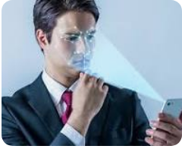
Peter Faulks Portfolio
What is biometric security?
Biometrics scanners are hardware used to capture the biometric for verification of identity. These scans match against the saved database to approve or deny access to the system. In other words, biometric security means your body becomes the “key” to unlock your access.
Biometric identification has a growing role in our everyday security. Physical characteristics are relatively fixed and individualized — even in the case of twins. Each person’s unique biometric identity can be used to replace or at least augment password systems for computers, phones, and restricted access rooms and buildings.
Once biometric data is obtained and mapped, it is then saved to be matched with future attempts at access. Most of the time, this data is encrypted and stored within the device or in a remote server.
Biometrics scanners are hardware used to capture the biometric for
verification of identity. These scans match against the saved database to approve
or deny access to the system. Uses Face, Eye, Hand or Finger Thumb etc.
In other words, biometric security means your body becomes the “key” to unlock your access.
Biometrics are largely used because of two major benefits:
Convenience of use: Biometrics are always with you and cannot be lost or forgotten.
Difficult to steal or impersonate: Biometrics can’t be stolen like a password or key can.
Peter Faulks Year 7 Digital Technologies. Slide 10

Slide 11
Peter Faulks Portfolio
Briefly describe 3 commonly used biometric security features. (what do they check?)
Three Types of Biometrics Security
While they can have other applications, biometrics have been often used in security, and you can mostly label biometrics into three groups:
Biological biometrics
Morphological biometrics
Behavioral biometrics
Biological biometrics use traits at a genetic and molecular level.
These may include features like DNA or your blood, which might be
assessed through a sample of your body’s fluids.
Morphological biometrics involve the structure of your body. More
physical traits like your eye, fingerprint, or the shape of your face can be
mapped for use with security scanners.
Behavioral biometrics are based on patterns unique to each person. How you walk, speak, or even type on a keyboard can be an indication of your identity if these patterns are tracked.
https://www.kaspersky.com/resource-center/definitions/biometrics
Peter Faulks Year 7 Digital Technologies. Slide 11

Slide 12
Peter Faulks Portfolio
What is encryption?
Encryption is a process that scrambles readable text so it can only be read by the person who has the secret code, or decryption key. It helps provide data security for sensitive information.
Vast amounts of personal information are managed online and stored in the cloud or on servers with an ongoing connection to the web. It’s nearly impossible to do business of any kind without your personal data ending up in an organization’s networked computer system, which is why it’s important to know how to help keep that data private.
Encryption plays an essential role in this task.
How does encryption work?
Encryption takes plain text, like a text message or email, and scrambles it into an unreadable format — called “cipher text.” This helps protect the confidentiality of digital data either stored on computer systems or transmitted through a network like the Internet.
When the intended recipient accesses the message, the information is translated back to its original form. This is called decryption.
To unlock the message, both the sender and the recipient have to use a “secret” encryption key — a collection of algorithms that scramble and unscramble data back to a readable format.
There are two main types of encryption systems: symmetric encryption and asymmetric encryption. Here’s how they’re different.
Symmetric encryption uses a single password to encrypt and decrypt data.
Asymmetric encryption uses two keys for encryption and decryption. A public key, which is shared among users, encrypts the data. A private key, which is not shared, decrypts the data.
https://us.norton.com/internetsecurity-privacy-what-is-encryption.html
Peter Faulks Year 7 Digital Technologies. Slide 12

Slide 13
Peter Faulks Portfolio
What is hacking?
Hacking—Definition, Types, Security, and More
A commonly used hacking definition is the act of compromising digital devices and networks through unauthorized access to an account or computer system. Hacking is not always a malicious act, but it is most commonly associated with illegal activity and data theft by cyber criminals.
Hacking refers to the misuse of devices like computers, smartphones, tablets, and networks to cause damage to or corrupt systems, gather information on users, steal data and documents, or disrupt data-related activity.
A traditional view of hackers is a lone rogue programmer who is highly skilled in coding and modifying computer software and hardware systems. But this narrow view does not cover the true technical nature of hacking. Hackers are increasingly growing in sophistication, using stealthy attack methods designed to go completely unnoticed by cybersecurity software and IT teams. They are also highly skilled in creating attack vectors that trick users into opening malicious attachments or links and freely giving up their sensitive personal data.
As a result, modern-day hacking involves far more than just an angry kid in their bedroom. It is a multibillion-dollar industry with extremely sophisticated and successful techniques.
https://www.fortinet.com/resources/cyberglossary/what-is-hacking
Peter Faulks Year 7 Digital Technologies. Slide 13

Slide 14
Peter Faulks Portfolio
What is a Denial of Service (D.o.S.) attack?
Distributed Denial of Service (DDoS) attack. A DDoS attack occurs when multiple systems orchestrate a synchronized DoS attack to a single target. Also known as a Denial-of-Service (DoS) attack is an attack meant to shut down a machine or network, making it inaccessible to its intended users. DoS attacks accomplish this by flooding the target with traffic, or sending it information that triggers a crash. In both instances, the DoS attack deprives legitimate users (i.e. employees, members, or account holders) of the service or resource they expected.
Victims of DoS attacks often target web servers of high-profile organizations such as banking, commerce, and media companies, or government and trade organizations. Though DoS attacks do not typically result in the theft or loss of significant information or other assets, they can cost the victim a great deal of time and money to handle.
There are two general methods of DoS attacks: flooding services or crashing services. Flood attacks occur when the system receives too much traffic for the server to buffer, causing them to slow down and eventually stop. Popular flood attacks include:
Buffer overflow attacks – the most common DoS attack. The concept is to send more traffic to a network address than the programmers have built the system to handle. It includes the attacks listed below, in addition to others that are designed to exploit bugs specific to certain applications or networks
ICMP flood – leverages misconfigured network devices by sending spoofed packets that ping every computer on the targeted network, instead of just one specific machine. The network is then triggered to amplify the traffic. This attack is also known as the smurf attack or ping of death.
SYN flood – sends a request to connect to a server, but never completes the handshake. Continues until all open ports are saturated with requests and none are available for legitimate users to connect to.
Peter Faulks Year 7 Digital Technologies. Slide 14

Slide 15
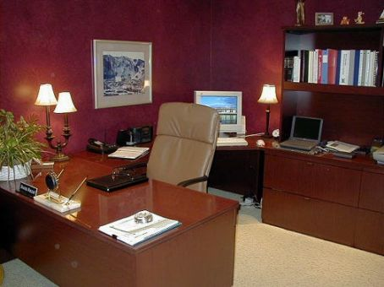
Portfolio Part 2 Hardware
Analyse and design a Computer Hardware System while taking into account the needs of a user or users.
TASK You have been asked to set up a home computer system for
your parents with a computer in an office and three other
computers in other rooms.
The main office computer will be the server computer
and you will need to have wi-fi to other computers.
List the type of computers that you would recommend
And what procedure you will take to protect the network?
You will also need to add some other equipment, list the
other equipment that you might need.
Use the next slides to create your home network starting
with the computers.
Peter Faulks Year 7 Digital Technologies. Slide 15

Slide 16
Portfolio Part 2 Hardware
My home Computers
Main Computer is
Answers may vary but image and reason should be included
Give some specifications
Specifications must be given
Peter Faulks Year 7 Digital Technologies. Slide 16

Slide 17
Portfolio Part 2 Hardware
My home Computers
2nd Computer is
Answers may vary but image and reason should be included
Give some specifications or reasons for your choice
Specifications must be given
Peter Faulks Year 7 Digital Technologies. Slide 17

Slide 18
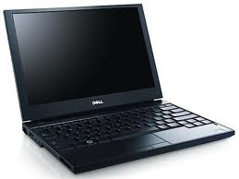
Portfolio Part 2 Hardware
My home Computers
3rd Computer is
Laptop: Dell Latitude E5400
On-the-Go Package: Latitude E5400 featuring Intel Core 2 Duo processor and Mini 10 Netbook
Answers may vary but image and reason should be included
Give some specifications or reasons for your choice
Specifications must be given
Peter Faulks Year 7 Digital Technologies. Slide 18

Slide 19
Portfolio Part 2 Hardware
My home Computers
4th Computer is
Answers may vary but image and reason should be included
Give some specifications or reasons for your choice
Specifications must be given
Peter Faulks Year 7 Digital Technologies. Slide 19

Slide 20
Portfolio Part 2 Hardware
My Network protection is as follows:-
Security Software
A firewall is a network security system designed to prevent unauthorized access to or from a private network. ... Network firewalls are frequently used to prevent unauthorized Internet users from accessing private networks connected to the Internet, especially intranets.
The defense strategies against malware differs according to the type of malware but most can be thwarted by installing
antivirus software,
firewalls,
applying regular patches to reduce zero-day attacks,
securing networks from intrusion, having regular backups and isolating infected systems.
Malware is now being designed to evade antivirus software detection algorithms
Peter Faulks Year 7 Digital Technologies. Slide 20

Slide 21
Portfolio Part 2 Hardware
Other Equipment
Answers may vary but image and reason should be included
Give some specifications
Specifications must be given
Peter Faulks Year 7 Digital Technologies. Slide 21

Slide 22
Portfolio Part 2 Hardware
Anything else you think should be included
Answers may vary but image and reason should be included
Give some specifications
Specifications must be given
Peter Faulks Year 7 Digital Technologies. Slide 22

Slide 23
Portfolio Part 2 Hardware
Anything else you think should be included
Peter Faulks Year 7 Digital Technologies. Slide 23

Slide 24
Portfolio Part 2 Hardware
Anything else you think should be included
Peter Faulks Year 7 Digital Technologies. Slide 24

Slide 25
Portfolio Part 2 Hardware
Anything else you think should be included
Peter Faulks Year 7 Digital Technologies. Slide 25

Slide 26
Portfolio Part 2 Hardware
Anything else you think should be included
Peter Faulks Year 7 Digital Technologies. Slide 26

Slide 27
Portfolio Part 2 Hardware
Anything else you think should be included
Peter Faulks Year 7 Digital Technologies. Slide 27

Slide 28
Portfolio
The End
Signature: I your name, advise that this work submitted is my own work and has not been copied or reproduced without reference to the appropriate author, website or source.
Peter Faulks Year 7 Digital Technologies. Slide 28

